Slide 1
How To Get Better Outcomes For Your Child, Transition Planning Starts Early!
June 9, 2023
1:30-2:30 pm
April Katine

Slide 2
Disability Rights Florida
Funding, responsibility, and authority under nine federal programs to protect the rights of Floridians with disabilities.
A not-for-profit corporation since 1987.
Offices in Tallahassee, Tampa, Fort Lauderdale, and Gainesville.
Satellite offices in several other communities.

Slide 3
Our Mission
To advance the quality of life, dignity, equality, self-determination, and freedom of choice of persons with disabilities through collaboration, education, advocacy, as well as legal and legislative strategies.

Slide 4

Objectives:
Learn about:
What Families can do to Get Started Early
Transition IEPs- What Should They Include?
Post High School Options
This Photo by Unknown Author is licensed under CC BY-NC

Slide 5
Transition Planning In Elementary Years
Holding high expectations for students with disabilities starting early is part of transition planning.
Finding their strengths and making sure they have opportunities to contribute to your family and community encourages independence and fosters higher expectations. Some questions to ask yourself.
Do you expect your child with a disability to do chores like their siblings?
Do you talk about what they want to be when they grow up? High, but realistic expectations?
Do they spend time contributing to your community? Volunteering?

Slide 6
Transition IEPs and The Law
Florida law requires transition planning to begin at age 12 or 7th grade, whichever comes first.
Florida law also requires the TIEP be implemented by 14, or the first day of high school, whichever comes first.
By age 16, or earlier, IDEA requires a student’s IEP team to address transition services the student needs to achieve their post-school goals.
Students with a 504 Plan are not legally required to have a transition plan, however, they are entitled to transition planning as part of their 504 Plan.

Slide 7
Students Should Be Part of The TIEP
Starting at age 12, or sooner, if possible, a student must be invited to be part of the TIEP.
If the student does not attend their TIEP meeting to identify their transition services needs or consider post-secondary and career goals, the school district shall take other steps to ensure that the students' preferences and interests are considered.

Slide 8

Transition Based on Information
Age 12 and 13, or earlier, IEP teams should focus on transition assessments and learning about the student’s strengths and interests.
Start by reviewing information about the student that is already available. These may include:
  State and district assessments.
  Classroom tests and student work product.
  Interviews with the student, teachers and parents.
  Identify what information may be missing that could help develop transition goals.
Notes:
State and district assessments – make sure you understand the scores. What do they mean? Ask lots of questions until you understand what the numbers mean. Many IEP teams say things like “they gained 13 points” what does that equate to?
Classroom tests and student work products – remember some of this is subjective. How much help did they require to pass those tests?
Interviews with student, teachers and parents – ask open ended questions – especially of the student. If the student says a lot of “I don’t know” then they need to be exposed to more possibilities, and experiences to determine what they do like. Students with the most significant disabilities may need the “Discover Process”. There are free trainings for school districts through Project 10.

Slide 9
Transition Assessments
Transition assessment should include record reviews to incorporate current information, goals, and results from prior testing, planning, and activities. This will ensure students are not needlessly retested on information you may already have.
Assessment activities should be positive and lead to self-empowerment.
Self-determination based on informed choices should be an overriding goal.
The purposes and goals of assessment should be clear.
Environmental factors affecting the individual should be considered.
Assessment reports should be written in easily understandable language. (Timmons, Podmostko, Bremer, Lavin, & Wills, 2005, pp. 1-8).
Source: Project 10 http://project10.info/DPage.php?ID=146

Slide 10
Formal Assessments
Some examples of formal transition information:
Florida Assessment of Student Thinking (FAST)
Florida Standards Alternate Assessment (FSAA)
College Entrance Test
Preliminary Scholastic Aptitude Test (PSAT)
American College Test (ACT)
College Placement Test (CPT)
Transition Planning Inventory
Brigance Transition Skills Inventory
Source: Project 10 http://project10.info/DPage.php?ID=146

Slide 11
Informal Assessments
Informal assessments are not standardized and may include observations, recreation or work-based assessments, inventories, rating scales and interviews. Examples of informal assessments include the following:
  Curriculum-based, teacher-made tests
  Interest inventories
  Observations
  Questionnaires
  Situational assessments
  Surveys
  Interviews
  Checklists
Source: Project 10 http://project10.info/DPage.php?ID=146

Slide 12
Students with Significant Cognitive Disabilities
Students with the most significant cognitive disabilities may need a more targeted assessment. Ask about The Discovery Process. If your school district says that they “don’t do that” or know how to do that, have them contact Project 10. They will provide, at no cost to the school, trainings on how to implement the Discovery process.
http://project10.info/DPage.php?ID=319#NS105
Discovery Process for Students in Transition, Part 1: Overview of the Discovery Process in Florida
Discovery Process for Students in Transition, Part 2: Developing Florida Discovery Student Profiles, Representational Portfolios, and Visual Résumés

Slide 13
What is The Discovery Process?
The person conducting the Discovery process interviews people familiar with the student, such as family members, teachers, community members.
This helps identify the strengths and abilities in the area of work the student already has (i.e., chores, volunteering).
Observes and interviews the student in multiple settings.
Develops a portfolio of what the student’s interests, abilities and desired employment outcome is.
Assists in customizing work-based learning experiences and ultimately provide job carving and employment outcomes for the student.

Slide 14
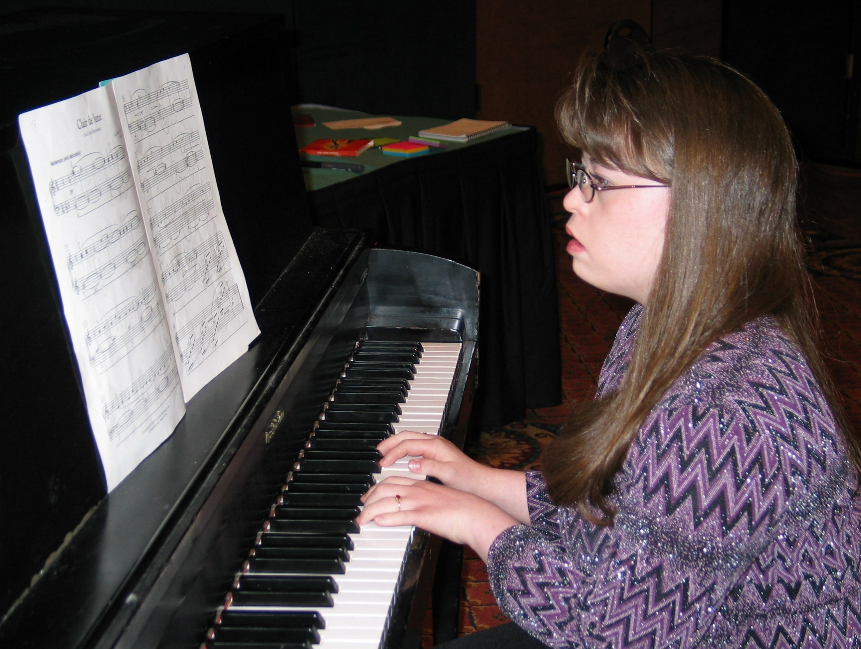
High School Begins
Age 14 and 15, or earlier if needed, should focus on laying the groundwork for what the student wants to learn.
  Electives should be focused on building the student prerequisites for their desired post school outcome.
  Examples:
    Student is interested in working in the medical field – should take extra classes in science.
    Student wants to work in television or the movies – should take drama, chorus keyboarding, computer animation, or TV production.

Slide 15

What Should the Transition IEP (TIEP) Include? (1 of 2)
The TIEP should include the need for instruction in self-determination
    Self-determination skills are those skills that a student needs to manage their own life, such as make your own choices, problems solve issues that come up, set and attain your goals and independently perform in life.
    These needed skills should be identified early according to Florida Rule 6A-603028

Slide 16
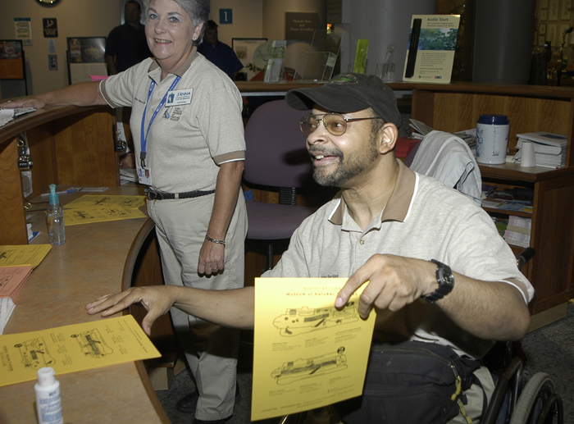
What Should the TIEP Include? (2 of 2)
  The TIEP should include the following based on the student’s needs:
  Vocational training and living skills
  High school program
  Desired post-school outcome
  Job training
  Post-school adult living
  Functional Vocational assessments
  Services and who will provide them
  Need for an assistive technology device

Slide 17
What a TIEP Is Not!
One size fits all or based on administrative convivence.
Same job readiness skills for all and the same skills taught repeatedly.
Group Community Based Instruction (CBI) where you only go to the places school has set up. (Publix, Burlington, Nursing home). If it is not your student’s desired post school outcome, then that is not where the training should be.
Learning skills that have nothing to do with your interests or abilities.
Spending years doing a microenterprise that the high school set up just because it is easy.
Picking electives based on where the group of ESE students fit in because that is where the paraprofessional is going. That is called administrative convenience.

Slide 18
Transfer of Rights
At least a year prior to turning 18, the school district must inform you and your parent or guardian that at 18 your educational rights will be transferred to you as an adult.
Once you are 18 you are considered an adult and you have the right to enter contracts and make your own decisions.
Once these rights have transferred to you at 18 and you should read everything carefully and make sure you understand it before you sign it.
Ask a trusted friend, family member or advocate if you need help understanding what you are being asked to agree to. This is called Supported Decision Making.

Slide 19
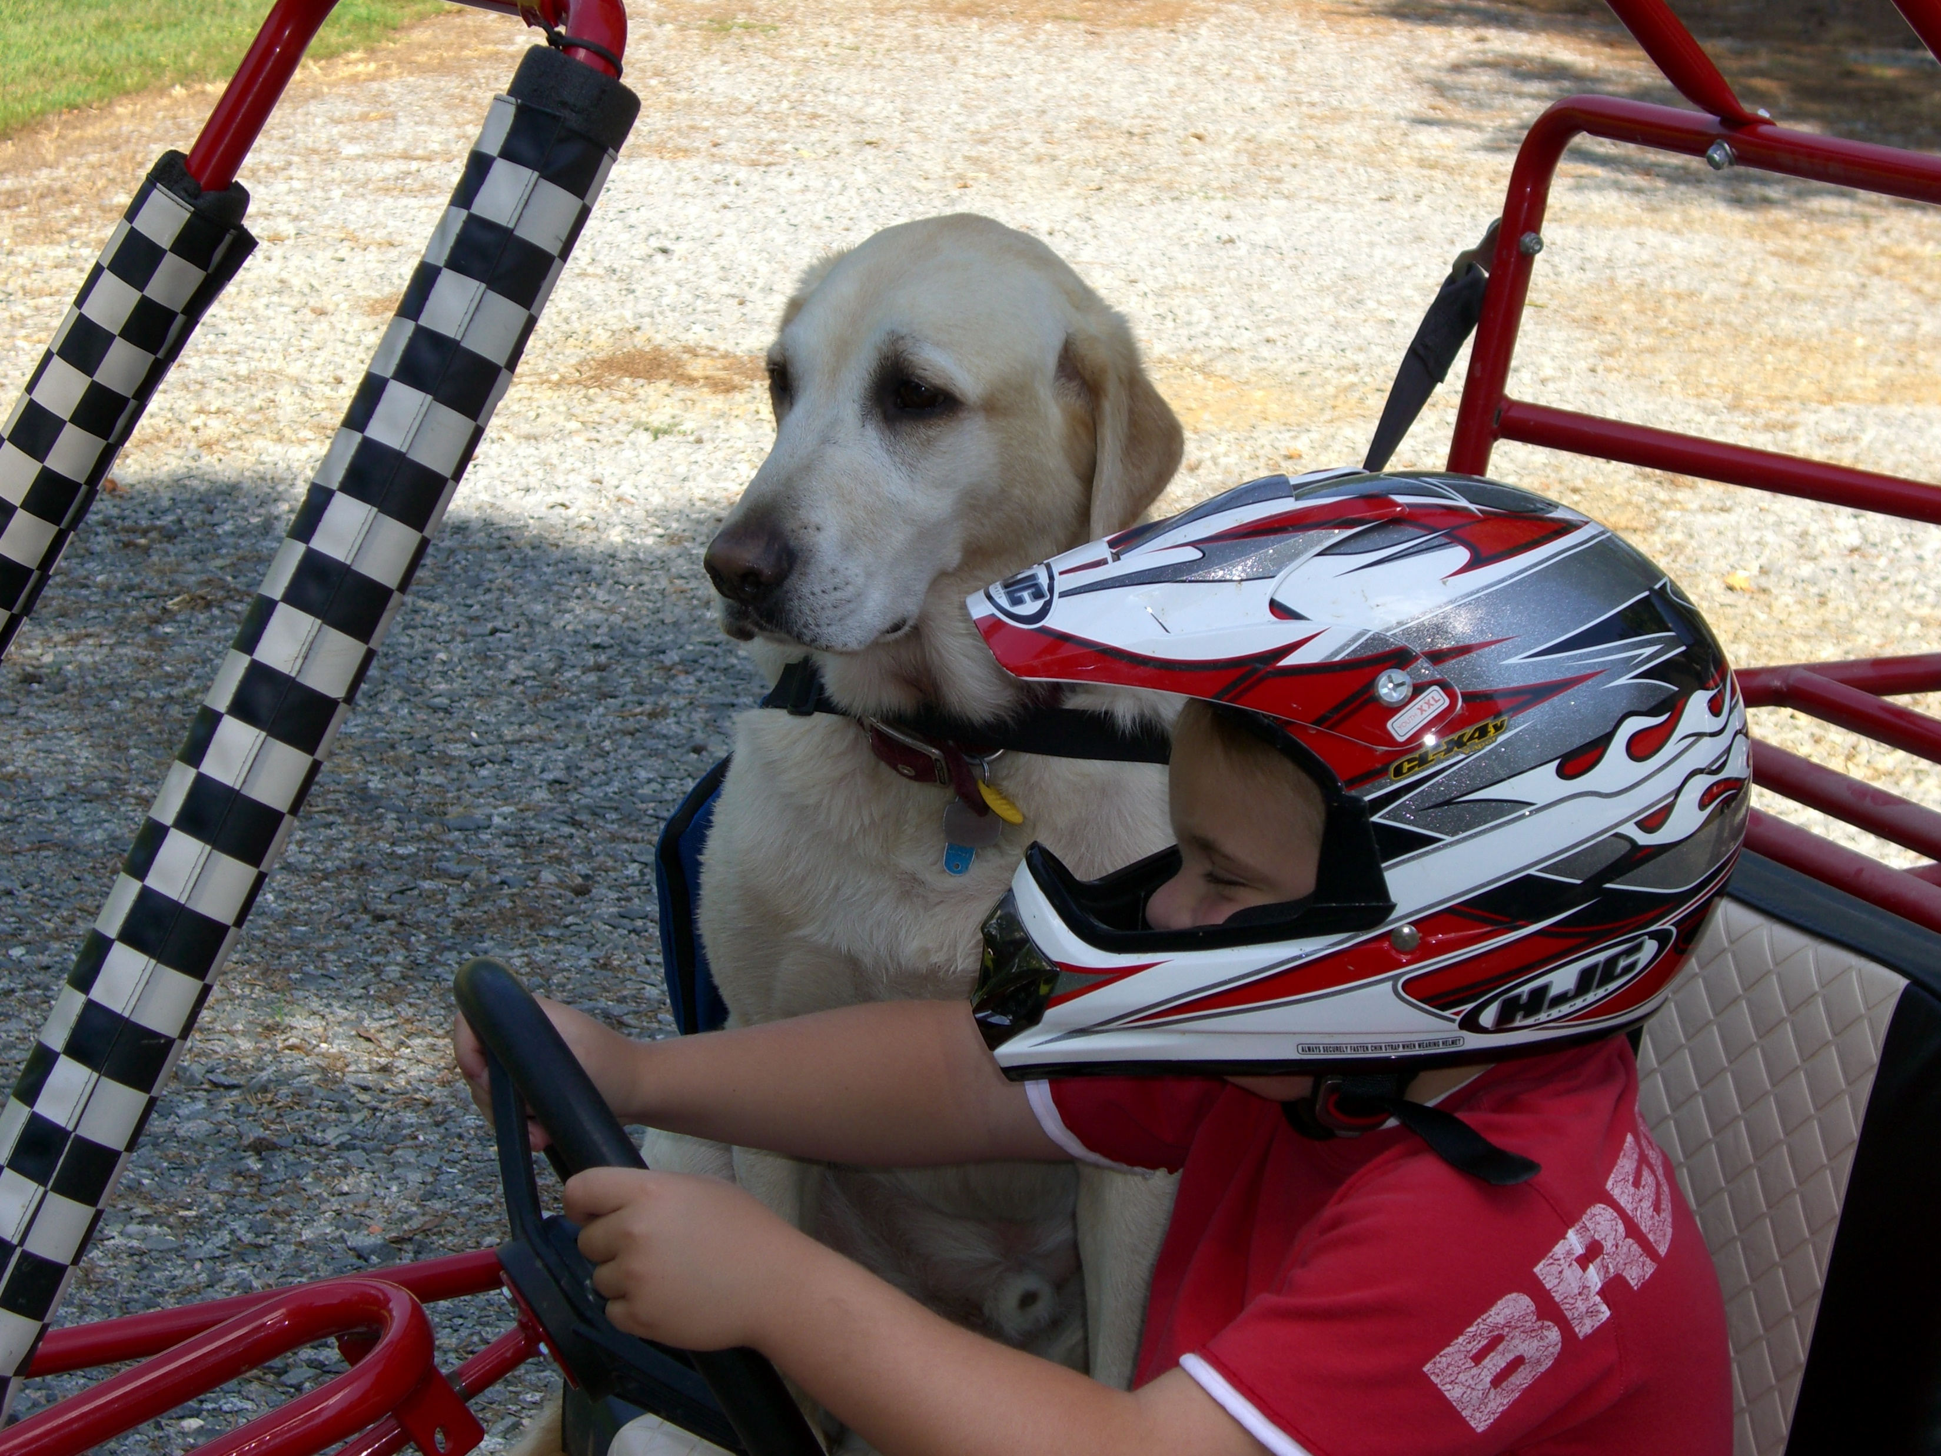
Supported Decision Making (1 of 2)
Consider using supported decision making rather than guardianship.
Learn all of the options related to helping people with disabilities keep all of the decision-making rights available, but still support them in learning to make their own decisions.
It gives people with disabilities the right to make mistakes just like you and me.
Notes:
Students with disabilities should be allowed to take risks and make mistakes just like people without disabilities. This is called “Dignity of Risk”.
Everyone learns by trial and error. If you find yourself scared of allowing your child, sister, brother or other family member to make mistakes, you are taking away one of the ways all people learn.

Slide 20
Supported Decision Making (2 of 2)
Supported decision making is the process that we all use to make choices in our lives. Everyone needs help making decisions sometimes.
If someone we want services from uses specialized language and they are hard to understand, we will ask friends, family or acquaintances to explain it to us, because they may understand the new information.
Once we get all the information and we understand the decision to be made, we are able to make our own decision. This is called Supported Decision Making.

Slide 21
Formal Supported Decision Making
Supported Decision making can be formalized in an agreement in which you detail all of the areas of your life with which you would like help making decisions.
In the agreement, you can say who you want to support you in each area, and how you do and do not want to be supported.
The person or people who will support you are chosen by you.
A Supported Decision-Making agreement can be written out and signed by all parties, but this is not required.

Slide 22
Support
Your chosen supporters can help you make informed decisions by:
Collecting and communicating with you about information related to the decision.
Help you understand and explore options.
Explain the risks and benefits of the different options.
Assist you in communicating and carrying out your decision.
Ultimately, the final decision is up to you.

Slide 23
In Florida
In Florida, at least one court has found that Supported-Decision Making agreements are a powerful alternative to guardianship.
To learn more, listen to the podcast interview with a Disability Rights Florida client who was able to end his guardianship and enter a Supported-Decision Making agreement that allowed him to keep all his rights. www.disabilityrightsflorida.org/podcast/story/episode_5_supported_decision_making.

Slide 24
Career And Technical Programs (CTE)
Each CTE career certificate program, 450 clock hours or longer, has identified associated basic academic skills (reading, mathematics and writing) that are required for completion from each CTE program. For the purpose of CTE and basic skills requirements, completion is accomplished when a student has demonstrated mastery of the entire program’s standards and benchmarks and receives a Career Certificate of Completion.
You will have to take the Test of Adult Basic Education (TABE test). Please note that this is an exit requirement. The Florida Department of Education (FDOE) does not have basic skills entrance requirements associated with CTE programs.

Slide 25
Test of Adult Basic Education Test
CTE Basic Skills Test Requirements 2019 - 2020 Technical Assistance Paper
Adult students with disabilities may be exempted from meeting the basic skills level required to earn a Career Certificate of Completion and be reported as a completer.
Dual enrolled students who have not met the basic skills requirements, may complete the program prior to high school graduation and then be counted as a completer once they have received their high school diploma.
All the requirements for full program completion would need to be earned by the end of the reporting year for the year in which they were enrolled.

Slide 26
Remediation Required
Following admission to a program, if a student is unable to demonstrate the basic skills exit requirements, remediation should be provided. After remediation, the student can test again using the same assessment instrument before the completion of the program. A student only needs to meet the basic skills requirements for exit from the program.
Remediation must be available to assist students in attaining the required basic skills levels and may be provided concurrently with enrollment in the CTE program, or, in certain cases (i.e., programs with waiting lists), prior to entry into the CTE program.

Slide 27
Alternate Way to Be a Completer
A student enrolled in a CTE program who does not meet the basic skills requirements but passes an identified licensure examination or certification after program completion, should be recorded as “incomplete” until the LEA receives documentation of the licensure and then may report the student as a completer from the CTE program. The student must be allowed to sit for an industry examination if he or she has successfully completed the CTE program in which the student is enrolled. The basic skills exit requirement is not a requirement of the licensing agencies.

Slide 28
Exemption
After remediation, if the student’s basic skills scores do not meet program exit requirements, the student may:
Remediate further and retest;
Pass a related state, national or industry licensure examination or certification;
Be exempt from meeting the basic skills requirements of the program if they are a student with a disability and provide appropriate documentation and request an exemption based upon the disability. Rule 6A-10.040, F.A.C., requires all LEAs to have a policy addressing exemptions for students with disabilities.

Slide 29
Project Search (1 of 2)
Project SEARCH is a nine-month transition-to-work internship program for people with disabilities. It is targeted for individuals whose goal is competitive employment. The program takes place in a business-led setting where total immersion in the workplace facilitates the teaching and learning process through hands-on training and the acquisition of employability and marketable work skills. Interns participate in three internships to explore a variety of career paths. The interns work throughout the year with a team that includes their family, an instructor and local and state agencies to create an employment goal. The goal of this nine-month program is competitive, integrated employment.

Slide 30
Project Search (2 of 2)
In Florida, Project SEARCH is a transition-age youth program for students who have met the requirements for their standard diploma, have deferred receipt of their diploma to participate in the transition program and are typically in the last year of eligibility for free and appropriate public education (FAPE). The target age for students in the program is 18-21 years of age but prefer students nearing the end of FAPE who are 20 or 21 years of age.

Slide 31
Agencies That Are Helpful at IEPs
Agency for Persons with Disabilities
Community Colleges
Division of Vocational Rehabilitation
Children’s Medical Services
Community Mental Health Services
Social Security Programs
Any other agency with services or programs that might contribute to the student’s successful transition to adult life.
Alcohol, drug abuse and mental health
Division of Blind Services
Deaf Services
Children and Families Services
Centers for Independent Living
Speech-Language Programs

Slide 32
Additional TIEP Members
The TIEP team must include the same required members as an IEP, however additional members may also be included.
The school district or parent or guardian may also invite people from such places as:
  higher education experts
  prospective adult living setting
  Prospective employers or employment training sites, job coaches, VR counselor or customized employment provider.

Slide 33
Preparing For Your IEP Meeting
If the purpose of the meeting is to consider your postsecondary goals and transition services, the student should be invited to the meeting.
These meetings are so important to the student’s future, the more they can be part of them, the better the team will work together.
Communication with the team is important. The more the team knows about the student’s strengths, desired post-school goals and where they need help, the more they can help them succeed.

Slide 34
Person Centered Planning (PCP)
The IEP team is there to help the student plan for their successful transition into adulthood.
Self-determination is key to the PCP approach.
Using the PCP approach the IEP meeting will focus on the student’s strengths, preferences, interests and needs.
The IEP team should work collaboratively to identify the student’s priorities and assist them in attaining their self-determined quality of life.

Slide 35
How Long Can You Stay In School?
Students with disabilities can stay in school until they receive a standard diploma on general education standards or until they turn 22.*
In some districts, it is the day you turn 22, the semester you turn 22 or the end of the school year in which you turn 22.
Check your District’s Special Programs and Procedures document:
https://beessgsw.org/#/spp/institution/public/
* Special circumstance may apply to defer even with the receipt of a standard diploma

Slide 36
The Deferral Process
First, a student must have an IEP that “prescribes special education, transition planning, transition services, or related services through 21.” This means that, because of the disability, a student must need continued special education and services.
Second, a student must be enrolled in one of several specific educational programs. These programs include accelerated college credit, industry certification courses that lead to college credit, a collegiate high school, courses necessary for a Scholar designation, or structured work-study, internship or pre-apprenticeship programs. School districts offer a variety of extended transition programs that meet these requirements.

Slide 37
Deadlines to Pay Attention to!
Before the first day of your senior year, typically at your annual IEP in 11th grade, the IEP team will ask you to decide if you will defer the receipt of your diploma or leave school when you meet all your graduation requirements.
Make sure they explain this to you and your child. If all they say is “Do you want to continue with high school after you meet graduation requirements?” This is not an explanation. It is important to think about this decision carefully. Once you accept your diploma and May 15th of your senior year passes, you cannot change your mind.
Has the school provided you with all the transition services you need to be successful in your post-secondary goals? If the answer is no, you may be entitled to receive those services at school, in a career and technology program, or at a state college or in the community.

Slide 38
Getting Involved with DVR Early
Students can get pre-employment transition services (Pre-ETS) through the Division of Vocational Rehabilitation (DVR) while in school. Many school districts are vendors of DVR and can start teaching basic employability skills while in high school.
You do not have to apply to be a client of DVR in order to take advantage of this service. At the student’s TIEP meeting you can indicate that you want to take part in Pre-ETS services.
One caution: If you apply for adult DVR services and are found ineligible for adult DVR services, you could lose your Pre-ETS eligibility. It is usually best to apply for adult DVR services around 16 years old if your student wants to be employable.

Slide 39
Individualized Plan for Employment
A student who has an IEP or 504 Plan is likely to leave school with an Individualized Plan for Employment (IPE) through the Florida Division of Vocational Rehabilitation (DVR).
The IPE is the blueprint to successful employment when using the services of the DVR or the Florida Division of Blind Services (DBS).
Without an IPE students cannot access the services of either DVR or DBS which helps them reach their employment goals in adult life.

Slide 40
IPE with DVR
The IPE states the student’s employment goal, and the services VR will provide in order to achieve it.
The employment goal should be specific enough to be clear and the services to help you reach your goal should be just as clear.
Examples of appropriate and inappropriate goals:
Appropriate Inappropriate
Nurses' aide Health care
Comptroller Business
Security guard law enforcement

Slide 41
What Should The IPE Include?
Detailed services needed to reach the goal
Further education needed
Transportation
Mental Health therapy
Medical Treatment
Technology
Career Counseling
Anything else necessary for the person to succeed

Slide 42

The IPE Team
The IPE is written by the student and their DVR counselor. It is helpful if the DVR counselor has been involved with the student from early on.
Other involved family members or IEP or 504 plan team member can also contribute to the plan, however, it is the student and the DVR counselor who must agree on the final plan.

Slide 43
Client Assistance Program (CAP)
The Client Assistance Program (CAP) is housed within Disability Rights Florida.
The CAP can assist individuals who are seeking services available under the Rehabilitation Act.
The CAP empowers individuals with disabilities to fully understand and exercise their rights to services.
CAP strives to assure people with disabilities are allowed to make informed choices throughout their vocational rehabilitation and independent living process and are treated with dignity and respect.

Slide 44
After High School (1 of 2)
IDEA does not apply to postsecondary education.
Once you are in postsecondary education the laws that govern your accommodations and equal access are Section 504 of the Rehabilitation Act and the Americans with Disabilities Act.
Postsecondary education will look different than what you may be used to in the Kindergarten to 12th grade system. There will not be IEP meetings or plans in place to spell out goals and services.
In postsecondary education you are more likely to work with a disability office to make sure you get accommodations, such as reduced course loads, assistive technology, extended time on tests and sign-language interpreters, if needed.

Slide 45
After High School (2 of 2)
To receive accommodations in a postsecondary setting you need to talk with the disability office and provide documentation or your disability and documents that indicate what accommodations are needed. This will not automatically happen. You need to contact the disability office and ask for their help.
The disability office can help with the accommodation needed; however, the postsecondary institution is not required to lower its academic standards or accept excessive financial burdens to provide those accommodations.

Slide 46

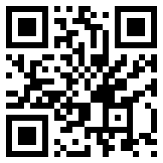
Transition Toolkit Available Now!

Slide 47

  Questions?

Slide 48
  Disability Rights Florida
  (800) 342-0823
  TDD (800) 346-4127
  FAX (850) 488-8640 www.DisabilityRightsFlorida.org
Follow Disability Rights Florida on
Facebook
Thank you

